Slide 1


Slide 2
History of C++

Slide 3
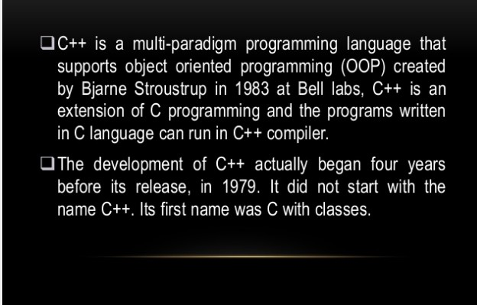

Slide 4
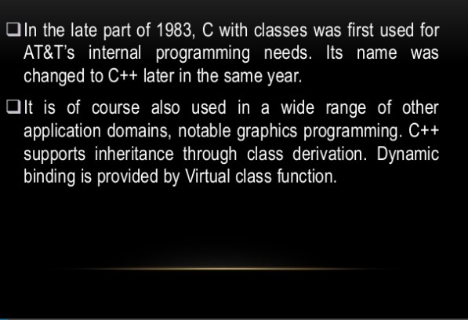

Slide 5
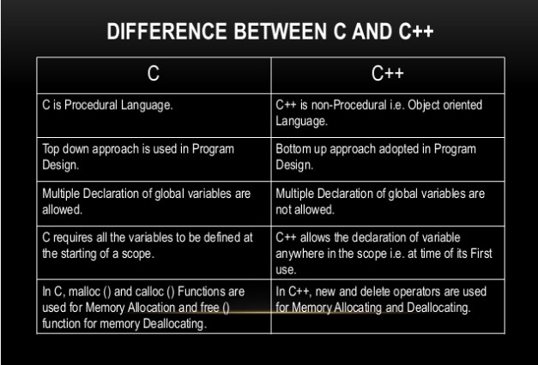

Slide 6
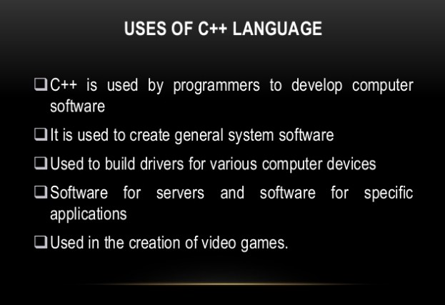

Slide 7
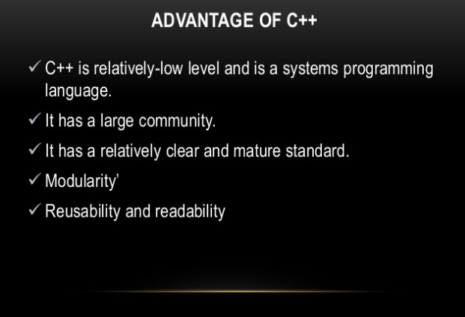
RULES

Slide 8
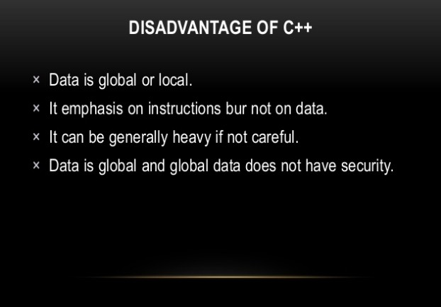

Slide 9
Algorithms &
FLOWCHARTS

Slide 10
Algorithms & flowcharts
A typical programming task can be divided into two phases:
Problem solving phase
produce an ordered sequence of steps that describe solution of problem
this sequence of steps is called an algorithm
Implementation phase
implement the program in some programming language

Slide 11
Steps in problem solving
First produce a general algorithm (one can use
pseudocode)
Refine the algorithm successively to get step by step detailed algorithm that is very close to a computer language.
Pseudocode is an artificial and informal language that helps programmers develop algorithms. Pseudocode is very similar to everyday English.

Slide 12
Purpose of program planning
To write a correct program, a programmer must write each and every instruction in the correct sequence
Logic (instruction sequence) of a program can be very complex
Hence, programs must be planned before they are written to ensure program instructions are:
Appropriate for the problem In the correct sequence

Slide 13
Pseudocode & algorithm
Example 1: Write an algorithm to determine a student’s final grade and indicate whether it is passing or failing. The final grade is calculated as the average of four marks.

Slide 14
Pseudocode:
Input a set of 4 marks
Calculate their average by summing and dividing by 4
if average is below 50 Print “FAIL”
else
Print “PASS”

Slide 15
Detailed Algorithm
Step 1:
Step 2:
Step 3:
Input M1,M2,M3,M4
GRADE ← (M1+M2+M3+M4)/4
if (GRADE < 50) then Print “FAIL”
else
Print “PASS”
endif

Slide 16
FLOWCHART
Flowchart is a pictorial representation of an algorithm
Uses symbols (boxes of different shapes) that have standardized meanings to denote different types of instructions
Actual instructions are written within the boxes
Boxes are connected by solid lines having arrow marks to indicate the exact sequence in which the instructions are to be executed
Process of drawing a flowchart for an algorithm is called
flowcharting

Slide 17
The Flowchart
A Flowchart
shows logic of an algorithm
emphasizes individual steps and their interconnections
e.g. control flow from one action to the next

Slide 18
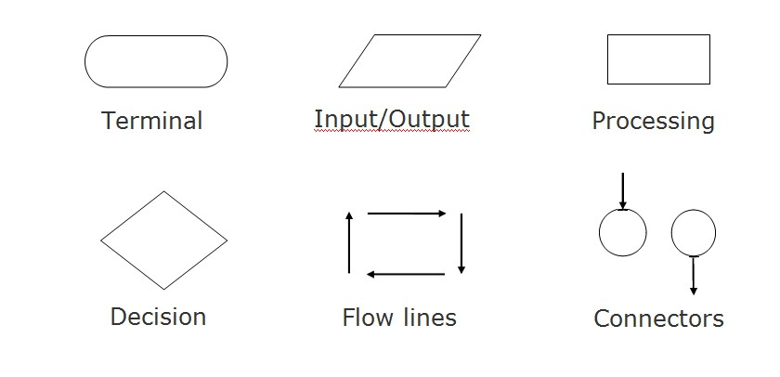
Basic flowchart symbols

Slide 19
Name
Symbol
Use in Flowchart
Oval
Denotes the beginning or end of the program
Parallelogram
Denotes an input operation
Rectangle
Denotes a process to be carried out
e.g. addition, subtraction, division etc.
Diamond
Denotes a decision (or branch) to be made. The program should continue along one of two routes. (e.g. IF/THEN/ELSE)
Hybrid
Denotes an output operation
Flow line
Denotes the direction of logic flow in the program

Slide 20
Example
START
Step 1:
Step 2:
Step 3:
Input M1,M2,M3,M4
GRADE ← (M1+M2+M3+M4)/4
if (GRADE <50) then Print “FAIL”
Input M1,M2,M3,M4
GRADE←(M1+M2+M3+M4)/4
else
Print “PASS” endif
N
IS GRADE<50
Y
PRINT “PASS”
PRINT “FAIL”
STOP

Slide 21
Example 2
Write an algorithm and draw a flowchart to convert the length in feet to centimeter.
Pseudocode:
Input the length in feet (Lft)
Calculate the length in cm (Lcm) by multiplying LFT with 30
Print length in cm (LCM)

Slide 22
Example 2
Flowchart
Algorithm
Step 1: Input Lft
START
Input Lft
Step 2:
Step 3:
Lcm ← Lft x 30 Print Lcm
Lcm ← Lft x 30
Print Lcm
STOP

Slide 23
Example 3
Write an algorithm and draw a flowchart that will read the two sides of a rectangle and calculate its area.
Pseudocode
Input the width (W) and Length (L) of a rectangle
Calculate the area (A) by multiplying L with W
Print A

Slide 24
Example 3
Flowchart
START
Algorithm
Step 1:
Step 2:
Step 3:
Input W,L
A ← L x W Print A
Input W, L
A ← L x W
Print A
STOP

Slide 25
Example 4
Write an algorithm and draw a flowchart that will calculate the
roots of a quadratic equation
ax² + bx + c = 0
Hint: d = sqrt (b² − 4ac ), and the roots are: x1 = (–b + d)/2a and
x2 = (–b – d)/2a

Slide 26
Example 4
Pseudocode:
Input the coefficients (a, b, c) of the quadratic equation
Calculate d
Calculate x1
Calculate x2
Print x1 and x2

Slide 27
Example 4
Flowchart
Algorithm:
START
Step 1:
Step 2:
Step 3:
Step 4:
Step 5:
Input a, b, c
d ← sqrt ( b × b − 4× a × c )
x1 ← (–b + d) / (2 x a)
x2 ← (–b – d) / (2 x a) Print x1, x2
Input a, b, c
d ← sqrt(b x b – 4 x a x c)
x₁ ←(–b + d) / (2 x a)
X₂ ← (–b – d) / (2 x a)
Print
x₁ ,x₂
STOP

Slide 28
DECISION STRUCTURES
The expression A>B is a logical expression
it describes a condition we want to test
if A>B is true (if A is greater than B) we take the action on left
print the value of A
if A>B is false (if A is not greater than B) we take the action on right
print the value of B

Slide 29
DECISION STRUCTURES
Y
is A>B
N
Print A
Print B

Slide 30
IF–THEN–ELSE STRUCTURE
The structure is as follows
If condition then
true alternative else
false alternative
endif

Slide 31
IF–THEN–ELSE STRUCTURE
The algorithm for the flowchart is as follows:
If A>B then
print A else
print B endif
Y
N
is A>B
Print A
Print B

Slide 32
Relational Operators
Relational Operators
Operator | Description
> | Greater than
< | Less than
= | Equal to
≥ | Greater than or equal to
≤ | Less than or equal to
≠ | Not equal to

Slide 33
Example 5
Write an algorithm that reads two values, determines the largest value and prints the largest value with an identifying message.
ALGORITHM
Step 1:
Step 2:
Input VALUE1, VALUE2
if (VALUE1 > VALUE2) then MAX ← VALUE1
else
MAX ← VALUE2
endif
Print “The largest value is”, MAX
Step 3:

Slide 34
Example 5
START
Input VALUE1,VALUE2
Y
is VALUE1>VALUE2
N
MAX ← VALUE1 |  |  | MAX ← VALUE2
Print
“The largest value is”, MAX
STOP

Slide 35
NESTED IFS
One of the alternatives within an IF–THEN–ELSE statement
– may involve further IF–THEN–ELSE statement

Slide 36
Example 6
Write an algorithm that reads three numbers and prints the value of the largest number.

Slide 37
Example 6
Step 1: Input N1, N2, N3
Step 2: if (N1>N2) then
if (N1>N3) then
MAX ← N1
else
MAX ← N3
endif else
if (N2>N3) then
MAX ← N2
else
MAX ← N3
endif endif
[N1>N2, N1>N3]
[N3>N1>N2]
[N2>N1, N2>N3]
[N3>N2>N1]
Step 3: Print “The largest number is”, MAX

Slide 38
Example 6
Draw the flowchart of the above Algorithm.

Slide 39
Example 7
Write an algorithm and draw a flowchart to
read an employee name (NAME), overtime hours worked (OVERTIME), hours absent (ABSENT) and
determine the bonus payment (PAYMENT).

Slide 40
Example 7
Bonus Schedule
OVERTIME – (2/3)*ABSENT | Bonus Paid
>40 hours >30 but ≤ 40 hours >20 but ≤ 30 hours >10 but ≤ 20 hours ≤ 10 hours | $50 $40 $30 $20 $10

Slide 41
Algorithm:
Step 1: Input NAME,OVERTIME,ABSENT
Step 2: if (OVERTIME–(2/3)*ABSENT > 40) then PAYMENT ← 50
else if (OVERTIME–(2/3)*ABSENT > 30) then PAYMENT ← 40
else if (OVERTIME–(2/3)*ABSENT > 20) then PAYMENT ← 30
else if (OVERTIME–(2/3)*ABSENT > 10) then PAYMENT ←20
else
PAYMENT ← 10
endif
Step 3: Print “Bonus for”, NAME “is $”, PAYMENT

Slide 42
Example 7
Draw the flowchart of the above algorithm?

Slide 43
Program development process
A programmer has to go through the following stages to develop a computer program:
Defining and Analyzing Problem
Designing the Algorithm
Coding or Writing the Program
Testing Program
Final Documentation

Slide 44

???
UESTIONS
Q
Thank You

